Slide 1
Optimizing Trading Strategies with Reinforcement Learning
Amulya Saxena
Travis Desell

Slide 2
Agenda – Stand up III
Update
Code Commits
Experiments

Slide 3
Update
Mid July – researched and documented next steps for fall semester
End Aug – Started studying and coding momentum-based strategies
Mid Sept – Experimenting with Moving averages and Relative strength index
Notes:
The only hold up is that, I need to see a lot of videos understanding the technical terms
- As each strategy is different and involves different components

Slide 4
Update
Implemented
UI Framework
Reinforce Algorithm
In Progress
Forecasting Model Integration
RL Agent (Experimenting with Different Algos)
UI – Giving errors with data integration

Slide 5
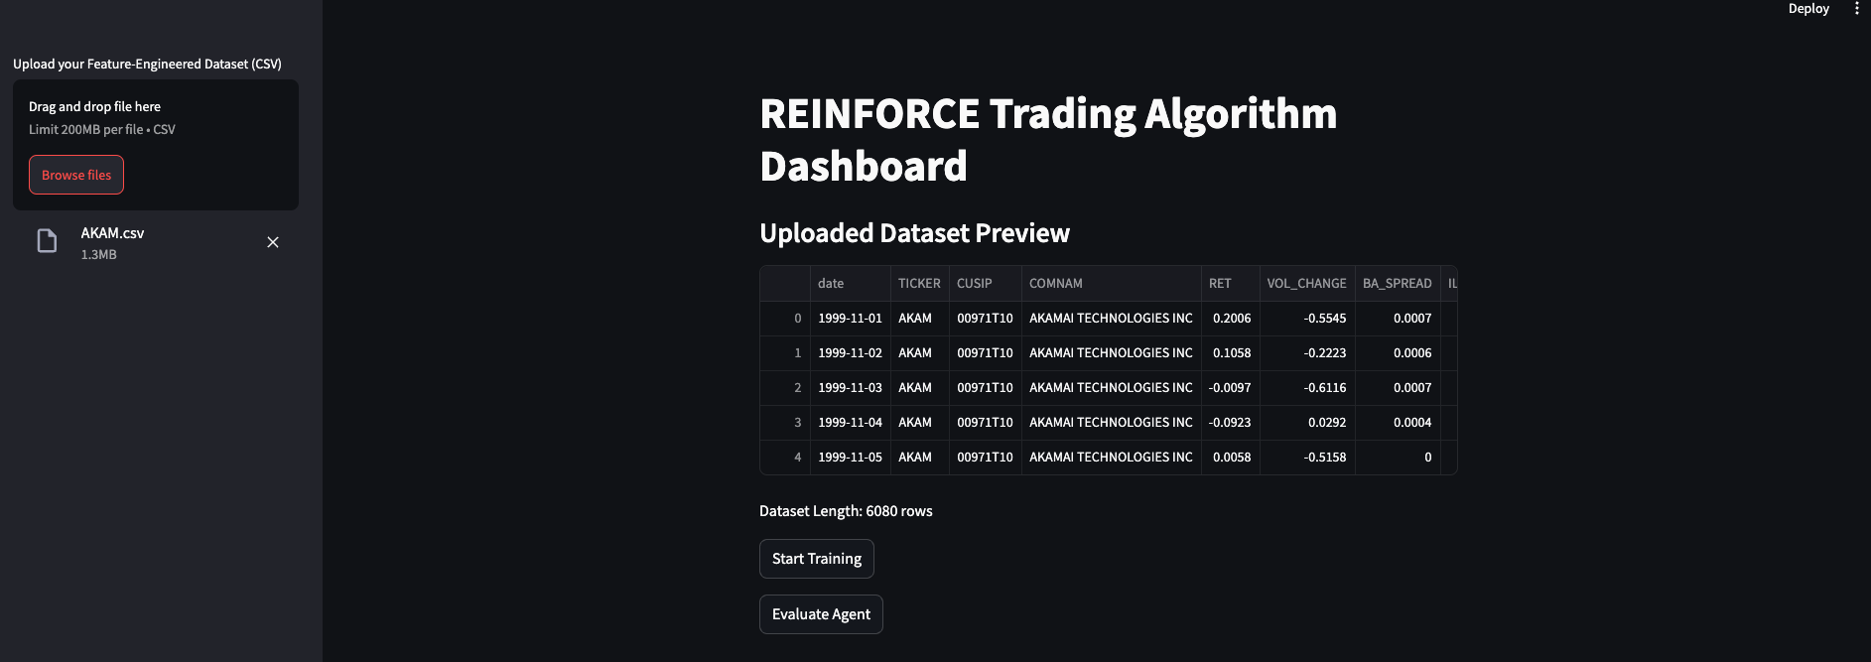

Slide 6
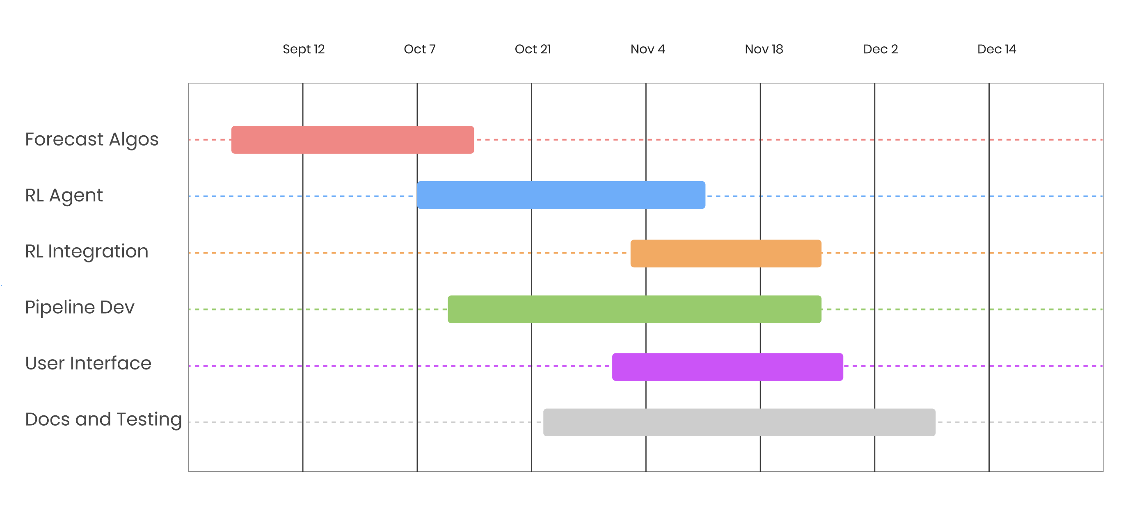
Gantt Chart

Slide 7
Update
Implemented
LSTM – Predicting Algorithm
Feature Importance and Selection
In Progress
VAR Model
TimeMixer Integration
RL Agent (Experimenting with Different Algos)
RL Environment

Slide 8
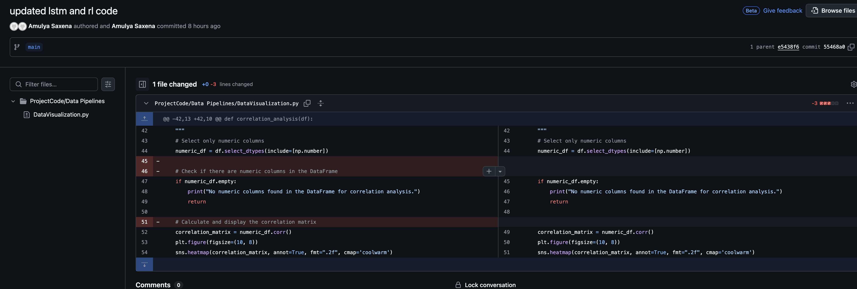

Slide 9
Experiments
Predicting Price and Returns using LSTM
1 Day
30 Days (Throwing error)
Notes:
Total Return shows how much profit the strategy made as a percentage of the initial capital.
Max Drawdown shows the worst-case scenario of how much the portfolio could have lost from its highest point.
Sharpe Ratio evaluates how much return you earned for the risk you took, with a higher ratio indicating a better risk-adjusted return.

